Slide 1
Documenting Architectures
Lecturer: Ngo Huy Bien
Software Engineering Department
Faculty of Information Technology
VNUHCM - University of Science
Ho Chi Minh City, Vietnam
nhbien@fit.hcmus.edu.vn

Slide 2

Objectives
To document software architectures.

Slide 3

Contents
Notations.
Semantics (Aspects, Contents).
UML Architecture Diagrams.
The 4+1 View Model.
The C4 Model.
Module Views.
Module Styles.
Component-and-Connector (C&C) Views.
Component-and-Connector Styles.
Allocation Views.
Allocation Styles.

Slide 4

References
Simon Brown (2019). Software Architecture for Developers - Volume 2: Visualise, Document and Explore Your Software Architecture. Leanpub.
Paul Clements et al. (2010). Documenting Software Architectures - Views and Beyond. Pearson.

Slide 5
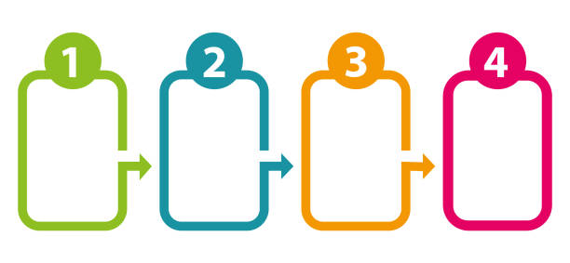
Notations
Boxes and Arrows
ADL
UML

Slide 6
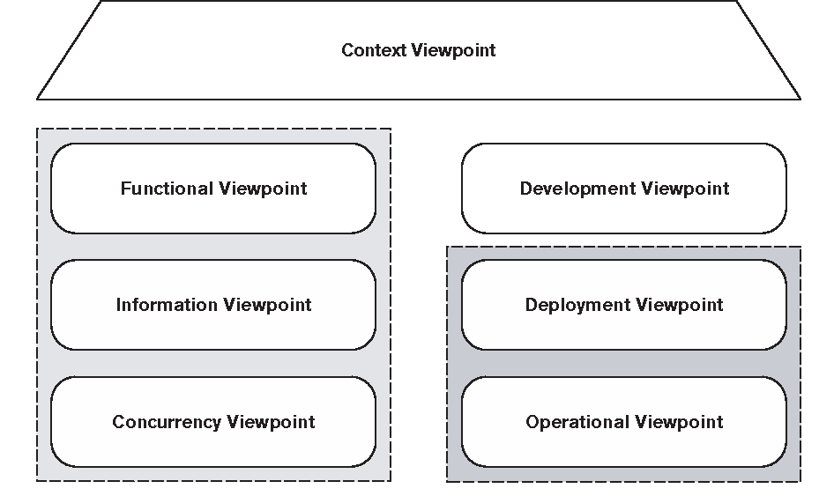
Semantics (Aspects, Contents)

Slide 7


Slide 8
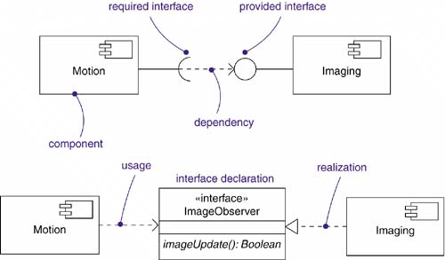
UML Architecture Diagrams
Package Diagrams
Component Diagrams
Artifact Diagrams
Deployment Diagrams

Slide 9
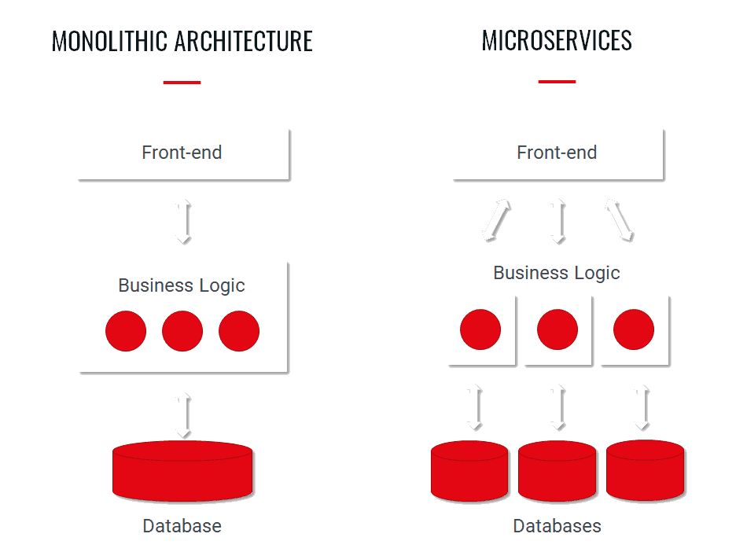
The 4+1 View Model Example
From monolith to microservices.

Slide 11
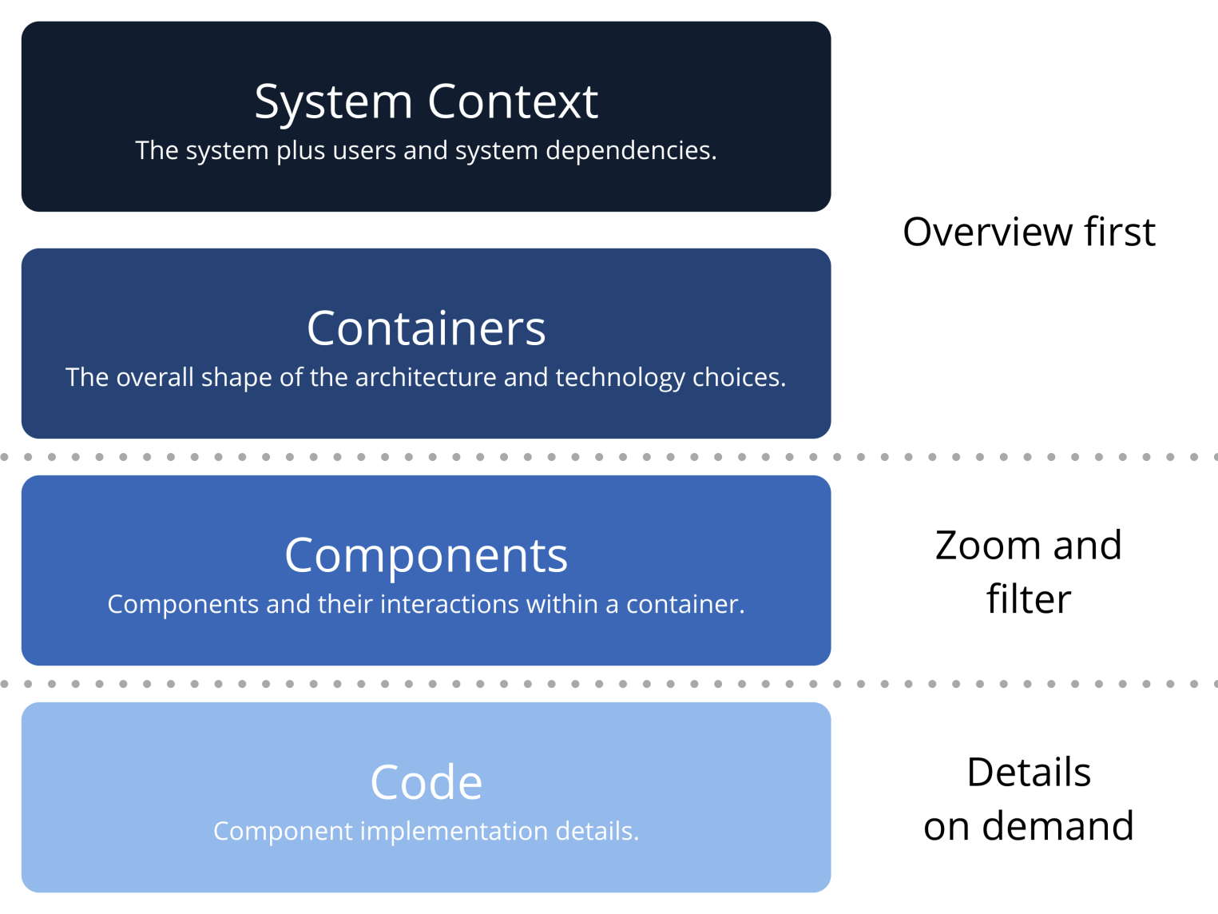
The C4 Model [1]

Slide 12
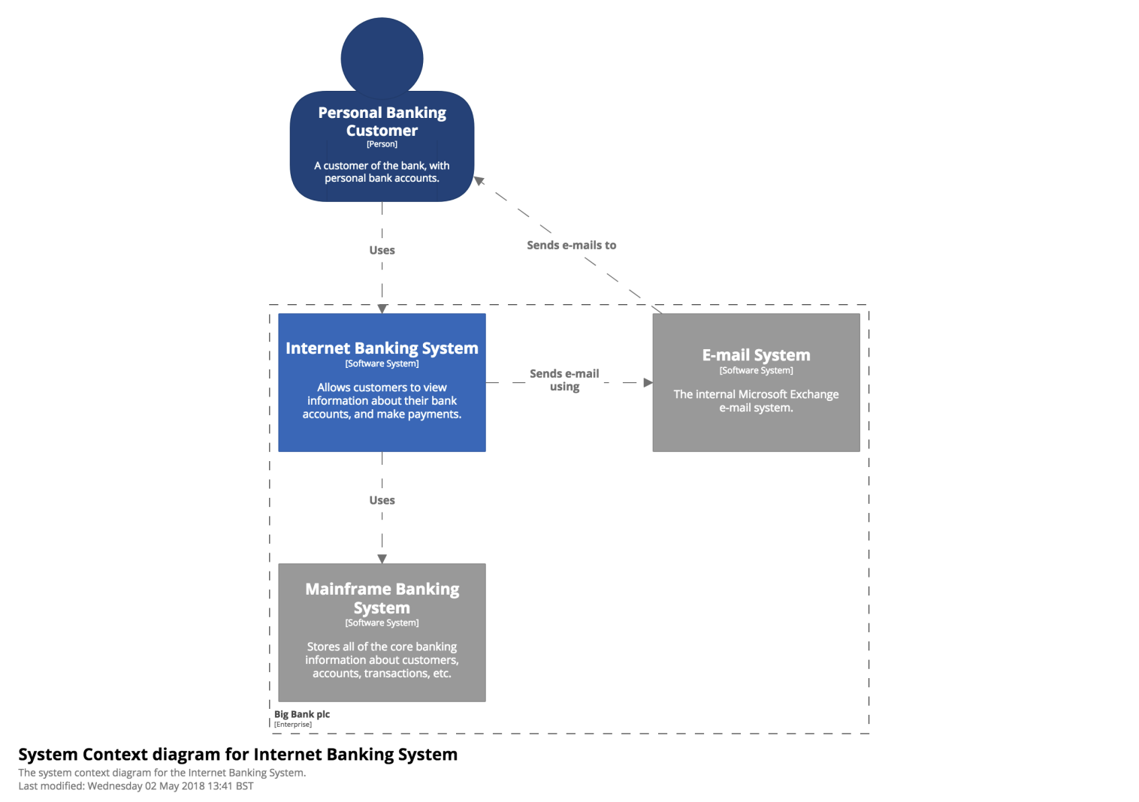
System Context

Slide 13
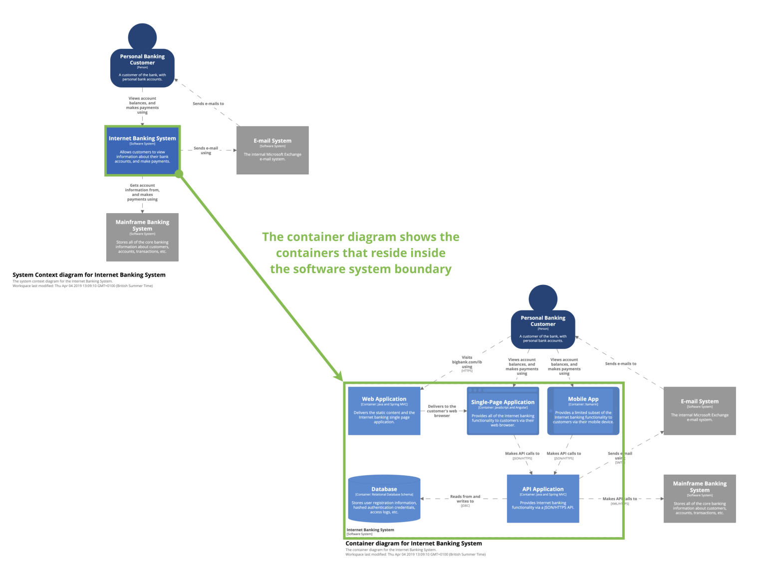
Container: System Zoom In

Slide 14
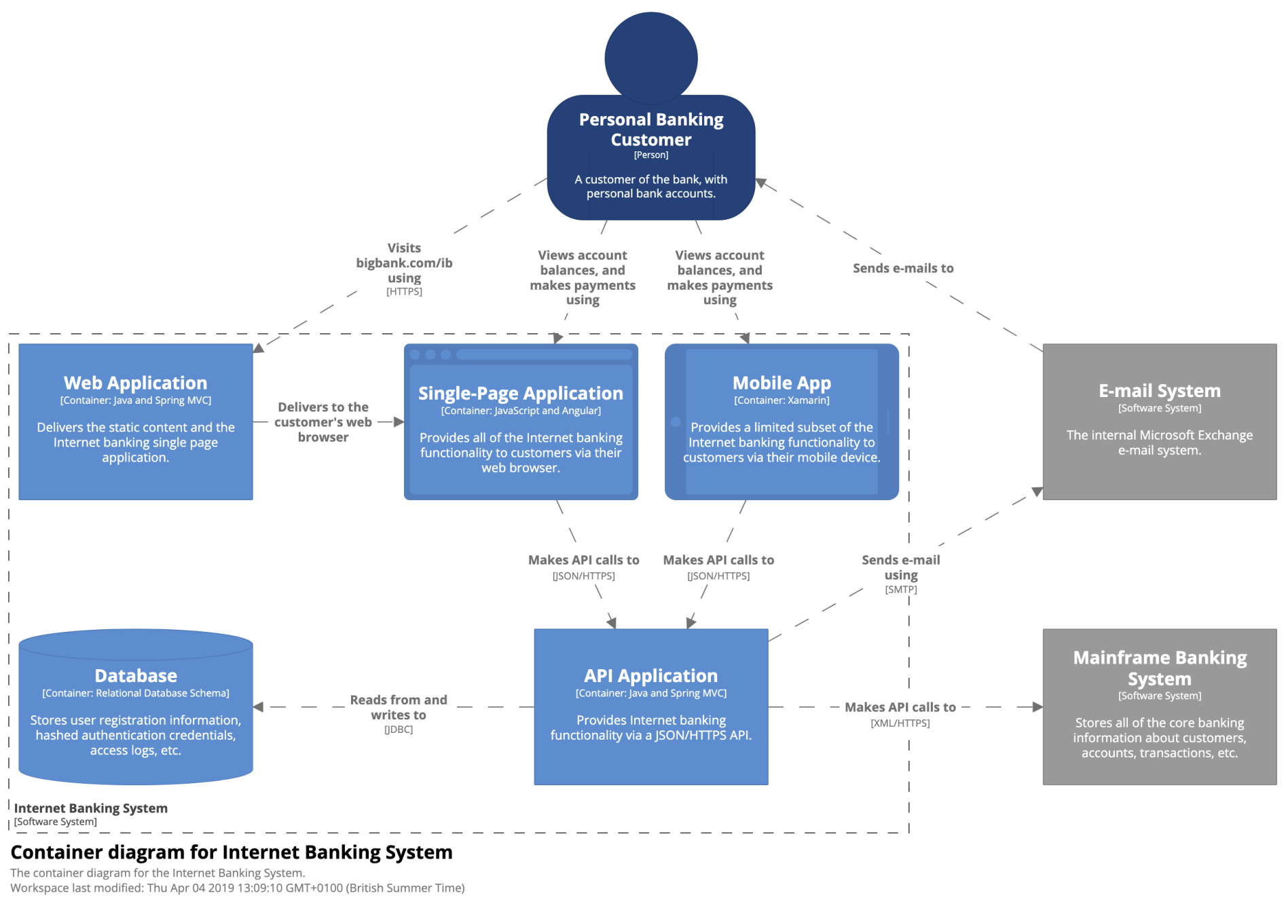
Container Detail

Slide 15
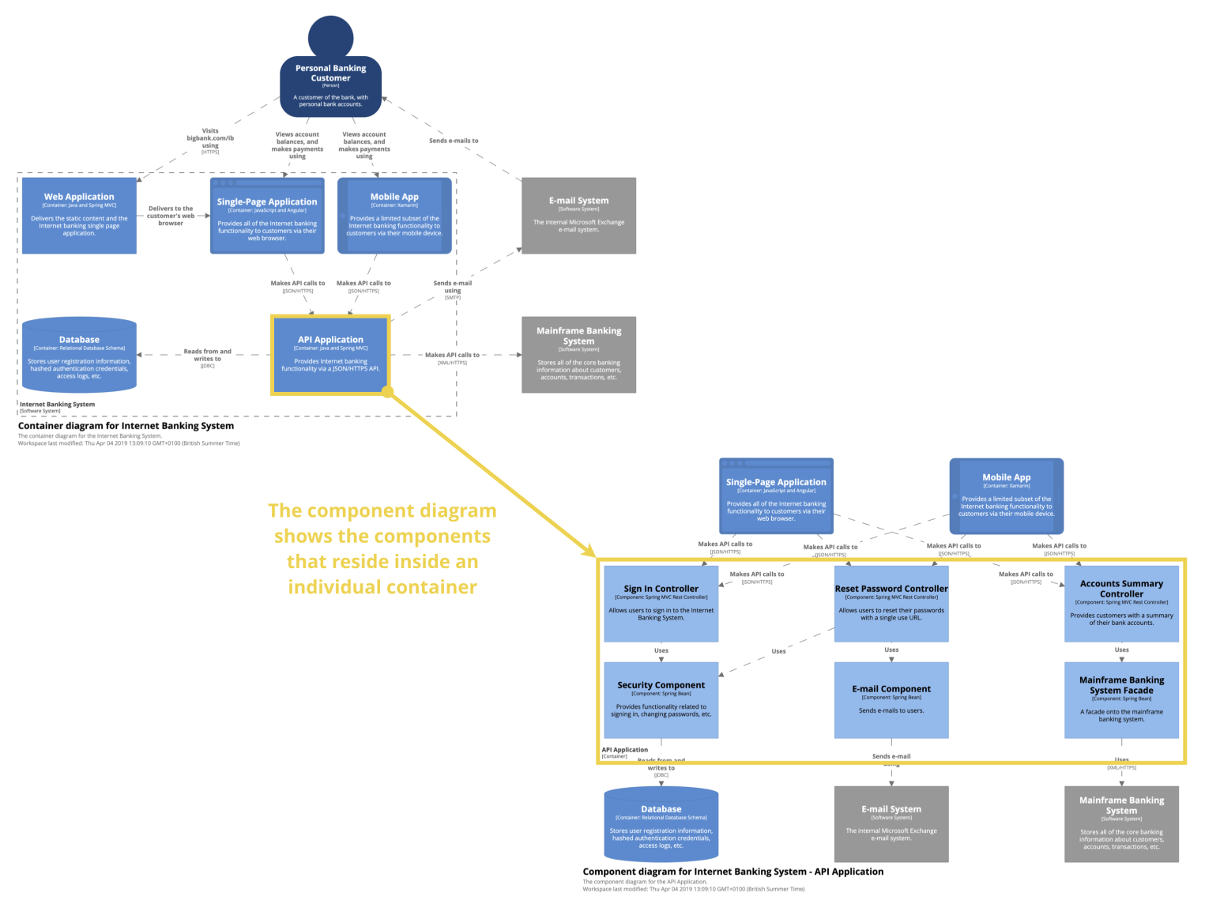
Component: Container Zoom In

Slide 16
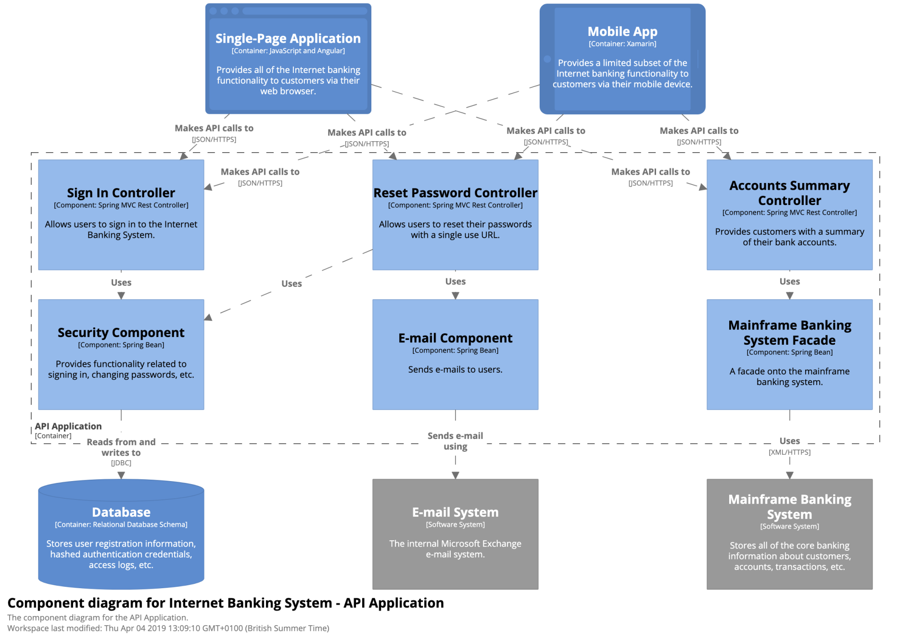
Component Detail

Slide 17
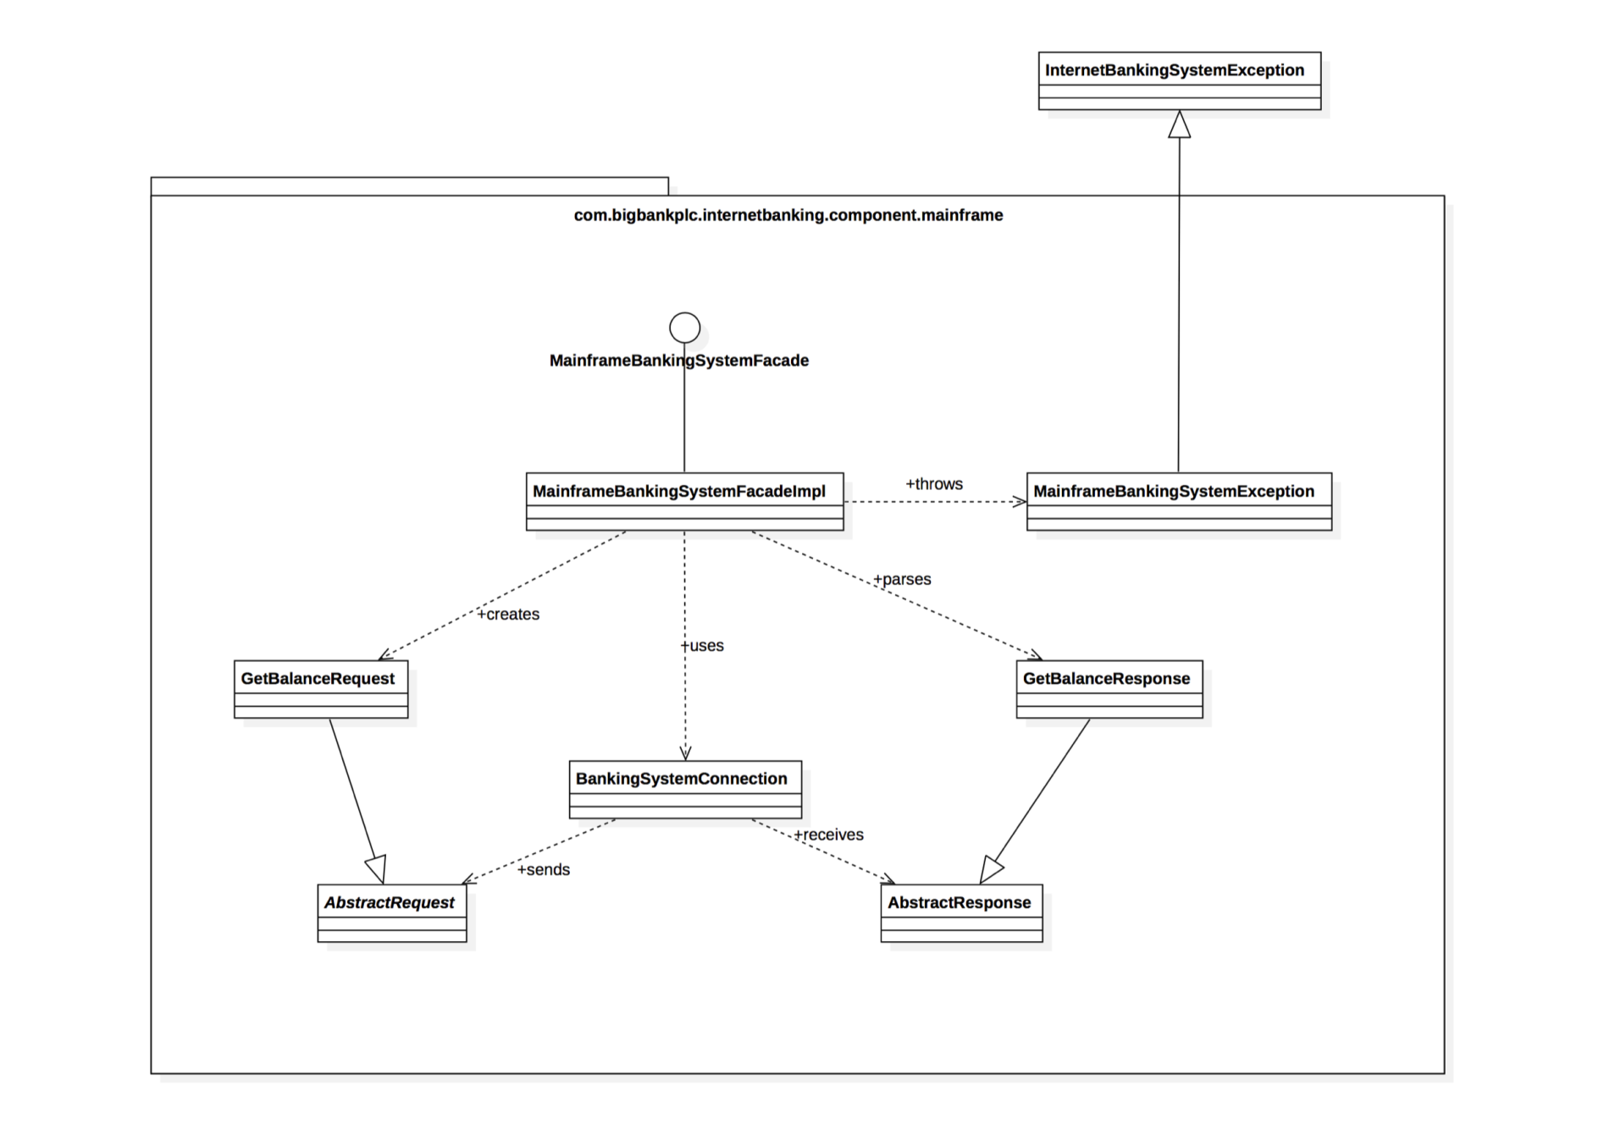
Code-Level Diagrams

Slide 18

Tools
https://c4model.com/tooling
https://structurizr.com/

Slide 20
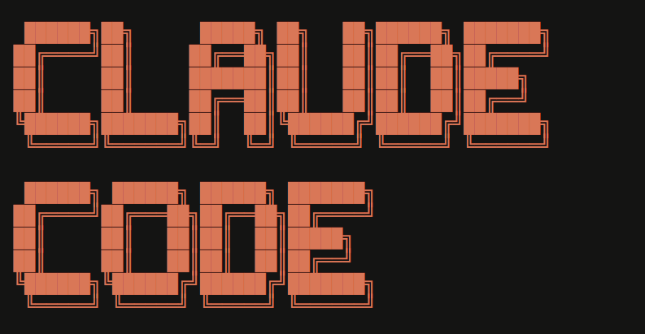
Exercise 1
Document and explain the architecture for Claude Code auto mode: https://www.anthropic.com/engineering/claude-code-auto-mode
Generate a PDF file containing a 4+1 view model and detailed information about the Claude Code auto mode: https://www.anthropic.com/engineering/claude-code-auto-mode
Generate a PDF file containing C4 model and detailed information about the Claude Code auto mode: https://www.anthropic.com/engineering/claude-code-auto-mode
Generate a PDF file containing flowchart and detailed information about the Claude Code auto mode: https://www.anthropic.com/engineering/claude-code-auto-mode

Slide 21

Exercise 2
Document and explain the architecture for Arm Metis: https://github.com/arm/metis
Create a PDF file in the docs folder containing a diagram that illustrates the technique used by Metis. The diagram should show that the input is a directory containing Python files and that the output is a report file listing the detected security bugs.
Generate a PDF file containing a diagram and detailed information about the TRIAGE technique.
Generate a PDF file containing a diagram and detailed information about the deterministic adjudication technique.
Set up environment using conda and the information in the .meta folder.
Create run.bat to run the Hello World.

Slide 23
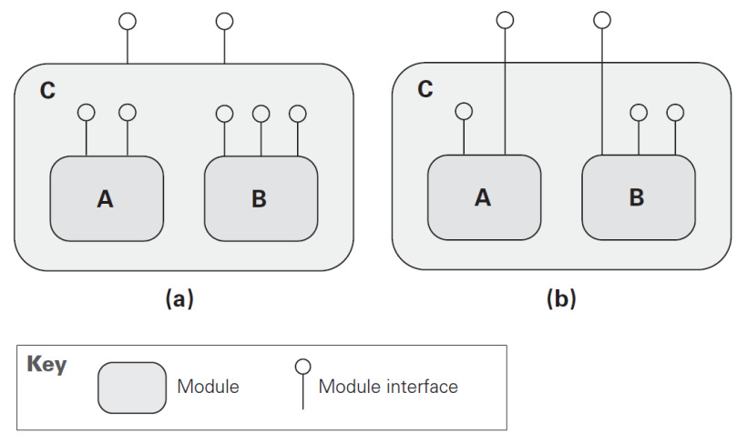
Module Views (I) [2]
Modules pertain to the way in which a system's software is decomposed into manageable units of responsibilities, which is one of the important forms of system structure.
A module view provides a blueprint for the source code and the data model.
Name.
Responsibility.
Visibility of interface(s).
Implementation information.
(a) Module C provides its own interface, hiding the interfaces of modules A and B. (b) Module C exposes a subset of the interfaces of modules A and B as its interface.

Slide 24
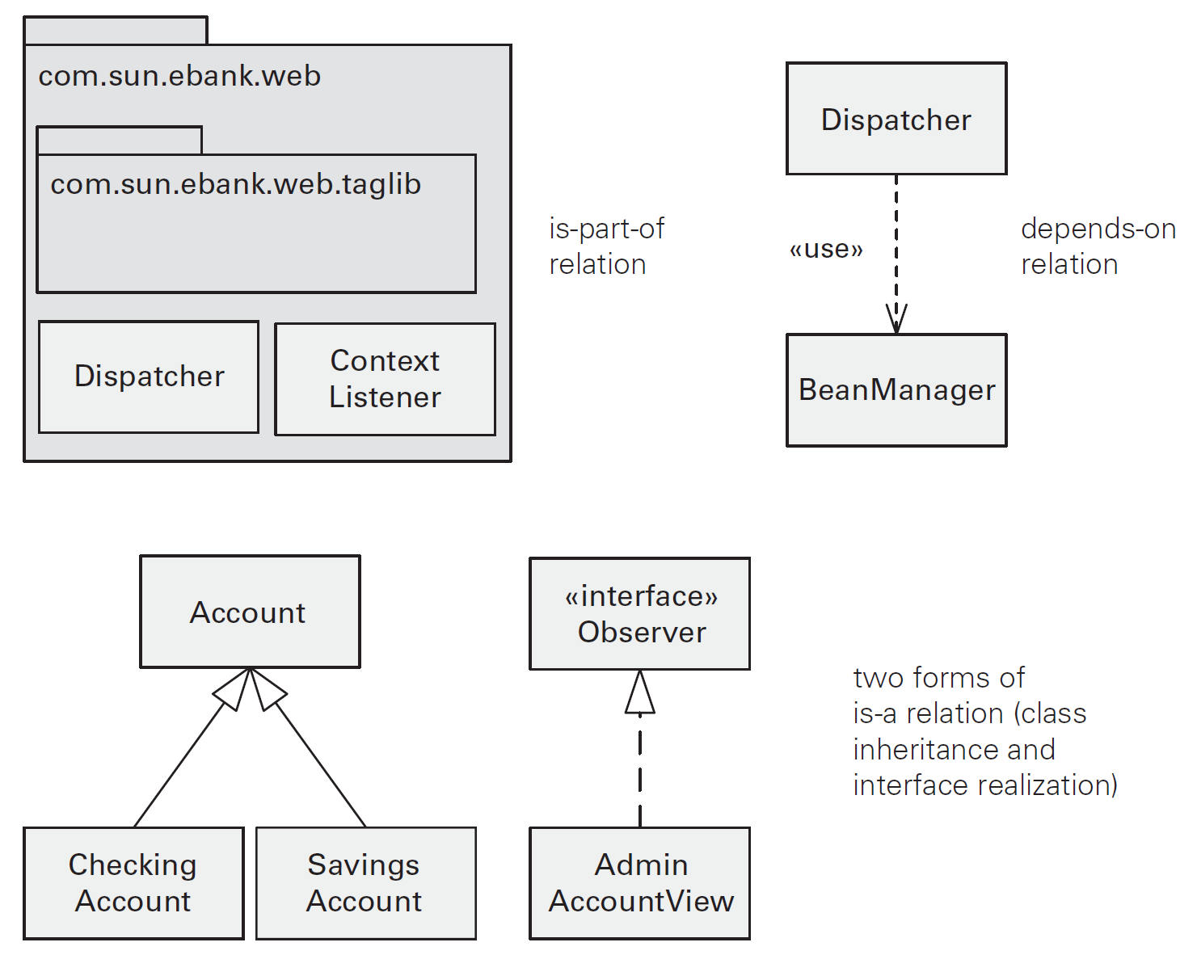
Module Views (II)
Modules are related to one another by forms of is-part-of, depends-on, and is-a relations.

Slide 26
Module Styles
The decomposition style, used to show the structure of modules and sub-modules (that is, containment relations among modules).
The uses style, used to indicate functional dependency relations
among modules.
The generalization style, used to indicate specialization relations among modules.
The layered style, used to describe the allowed-to-use relation in a restricted fashion between groups of modules called layers.
The aspects style, used to describe particular modules called aspects that are responsible for crosscutting concerns.
The data model style, used to show the relations among data entities.

Slide 27
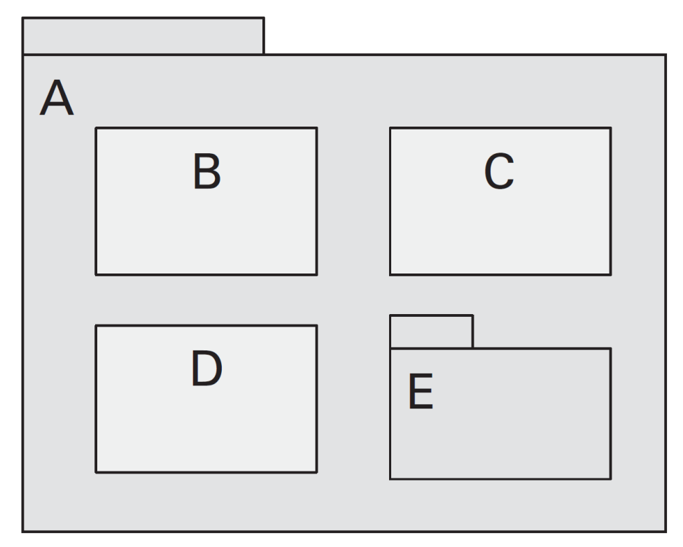
Decomposition Style
A decomposition view shows how responsibilities are allocated across modules and sub-modules.
In UML, module decomposition is shown by nesting, with the aggregate module shown as a package.

Slide 28
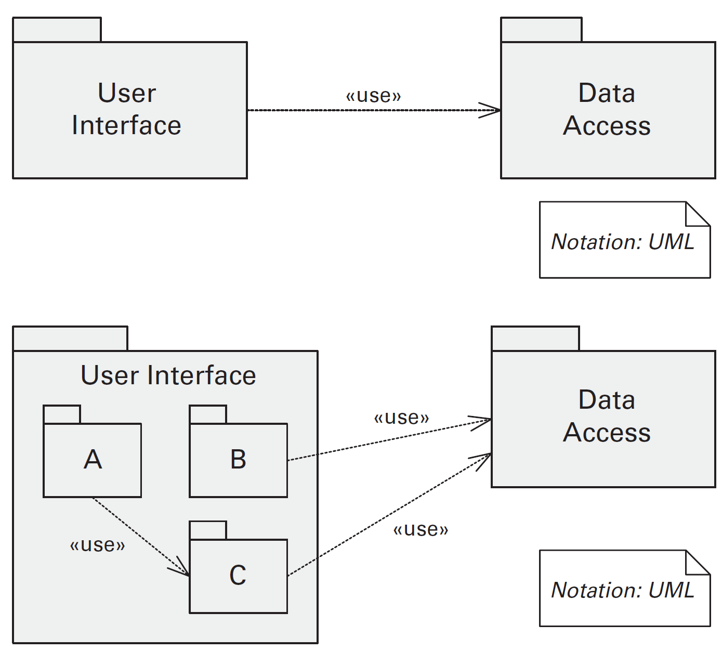
Uses Style
A uses view shows how modules depend on one another.
This view helps achieve incremental development and is especially suitable for performing change-impact analysis.
The User Interface module has been decomposed into modules A, B, and C.
At least one of the modules must depend on the Data Access module or the decomposition would not be consistent.

Slide 29
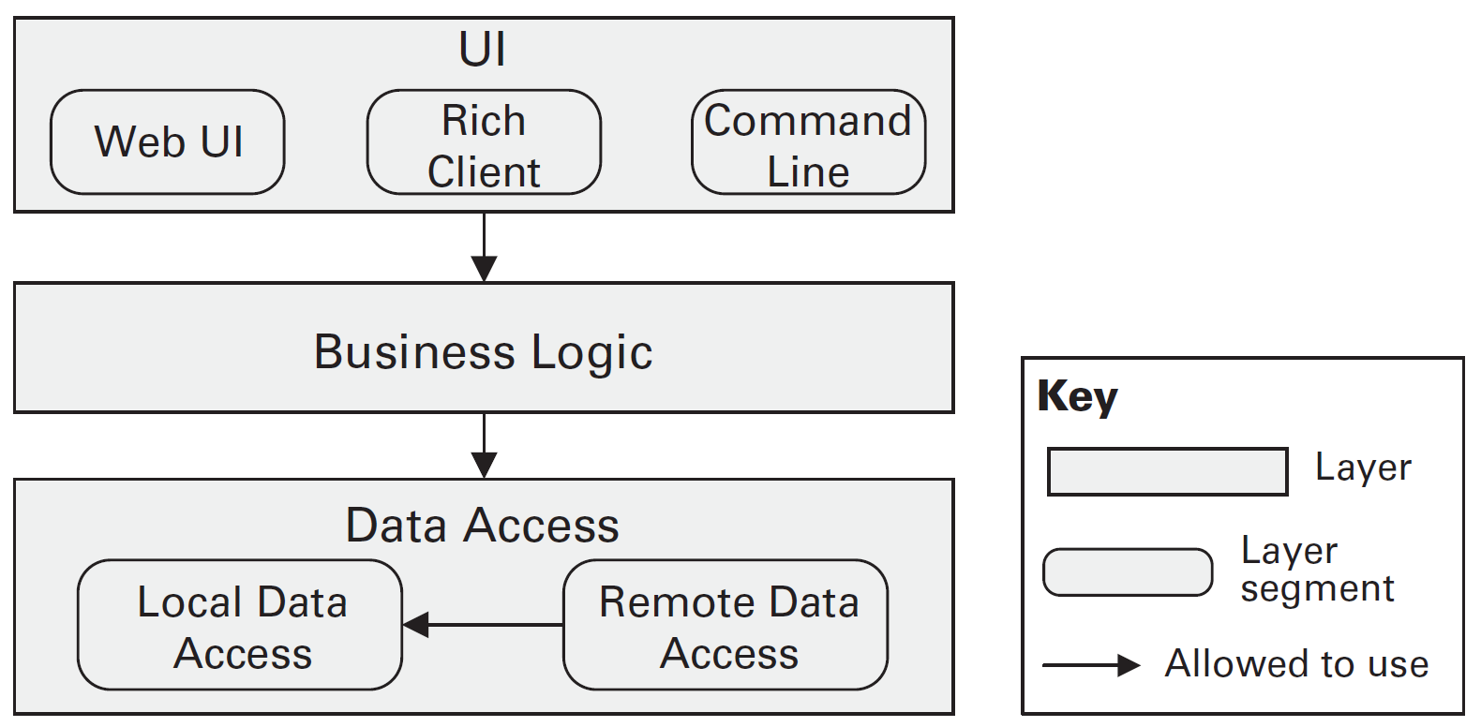
Layered Style (I)
A layered view divides a system into groups of modules that provide cohesive responsibilities.
These groups are called layers and relate to each other uni-directionally by the allowed-to-use relation.
A layered design helps a system achieve portability and modifiability.
Layered design with segmented layers.

Slide 30
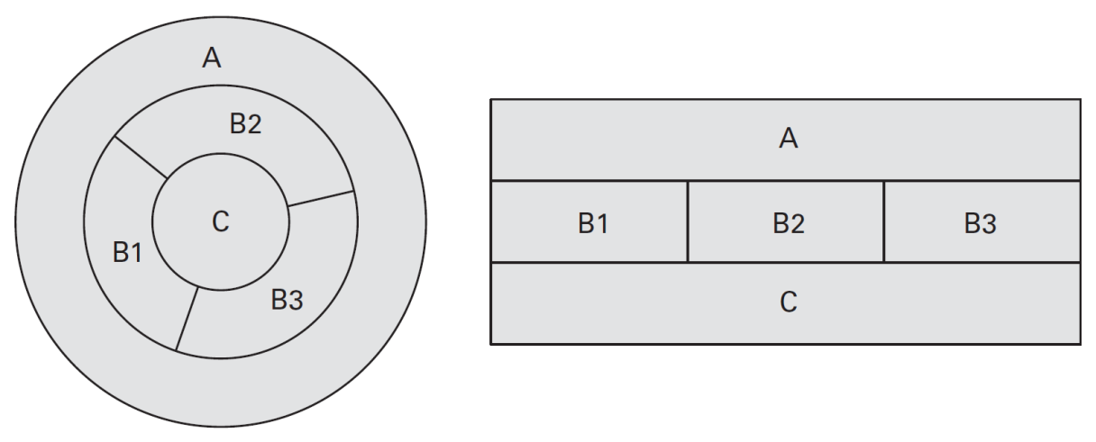
Layered Style (II)
A layered design shown as concentric rings and as a stack of boxes. Are these two representations equivalent?
In the layer diagram, B1 and B3 are separate; in the ring diagram they are adjacent.

Slide 31
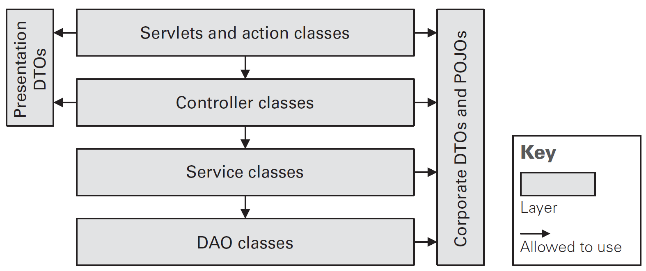
Layered Style (III)
Layers with a “sidecar.”
The key should make clear what is allowed to use and be used by software in the box on the side.

Slide 33

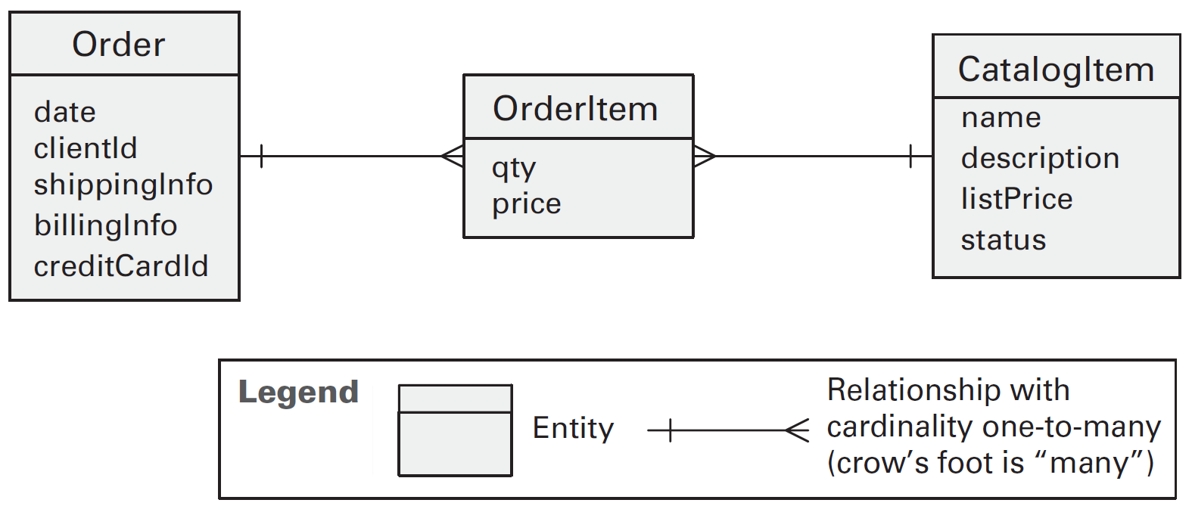
Data Model View
A data model view describes the structure of the data used in the system in terms of data entities and their relationships.
It guides implementation and helps to improve performance and modifiability in data-centric systems.
A conceptual
data model
A logical data model

Slide 34
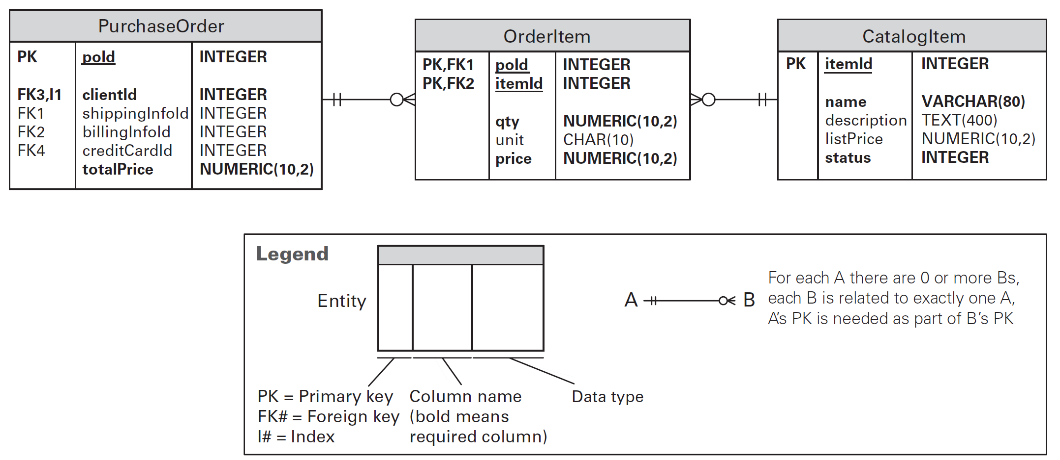
Physical Data Model
Physical data model that was created by adding implementation details and optimizations to the logical data model.

Slide 36
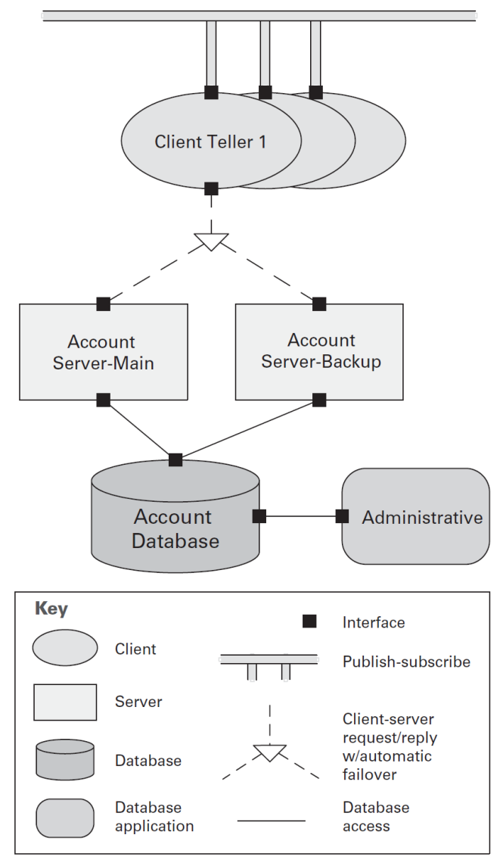
Component-and-Connector (C&C) Views
Component-and-connector views describe structures consisting of elements that have runtime presence, such as processes, objects, clients, servers, and data stores.
Component-and-connector views show instances, not types.
Components have interfaces, which are called ports.
Connectors have interfaces, which are called roles.

Slide 37
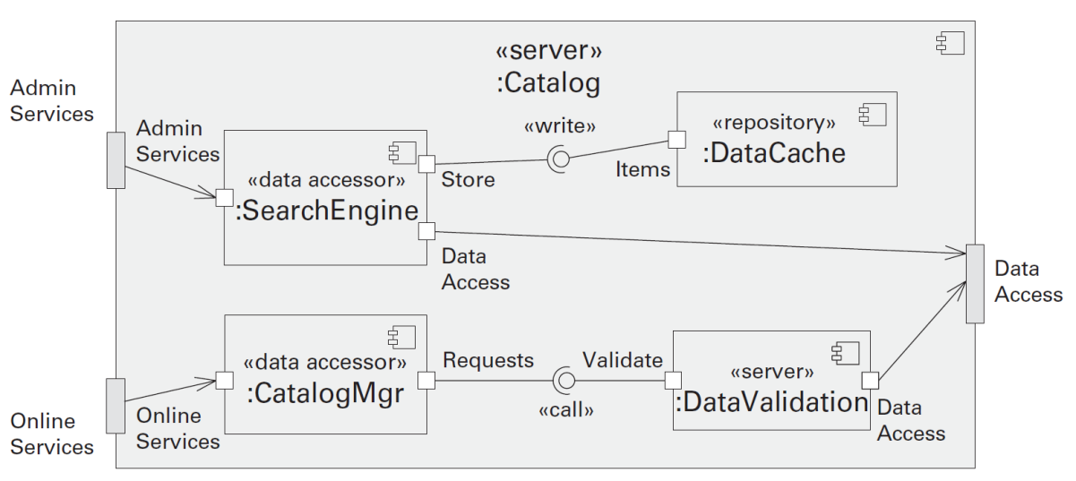
Attachment Relation
A role defines a point of interaction of a connector and indicates how components may use a connector in interactions.
The primary relation within a C&C view is attachment.
Attachments indicate which connectors are attached to which components, thereby defining a system as a graph of components and connectors.
Specifically, an attachment is denoted by associating (attaching) a component's port to a connector's role.

Slide 38
Interface Delegation Relation
A second kind of relation is interface delegation. When a component or connector has a sub-architecture, it is important to document the relationship between the internal structure and the external interfaces of that component or connector.
A UML component diagram showing the sub-architecture of a component called Catalog.
UML delegation connectors associate the ports of Catalog with the ports of internal components.

Slide 40
Component-and-Connector Styles
A component-and-connector (C&C) style introduces a specific set of component-and-connector types and specifies rules about how elements of those types can be combined.
Additionally, given that C&C views capture runtime aspects of a system, a C&C style is typically also associated with a computational model that prescribes how data and control flow through systems designed in that style.

Slide 41
Pipe-and-Filter Style
Pipes connect filter output ports to filter input ports.
Connected filters must agree on the type of data being passed along the connecting pipe.
Specializations of the style may restrict the association of components to an acyclic graph or a linear sequence—sometimes called a pipeline.
Other specializations may prescribe that components have certain named ports, such as the stdin, stdout, and stderr ports of UNIX filters.

Slide 42
Why Pipe-and-Filter Style?
Systems conforming to a pipe-and-filter style are typically used in data transformation systems, where the overall processing can be broken down into a set of independent steps, each responsible for an incremental transformation of its input data.
The independence of the processing done by each step supports reuse, parallelization, and simplified reasoning about overall behavior.

Slide 43
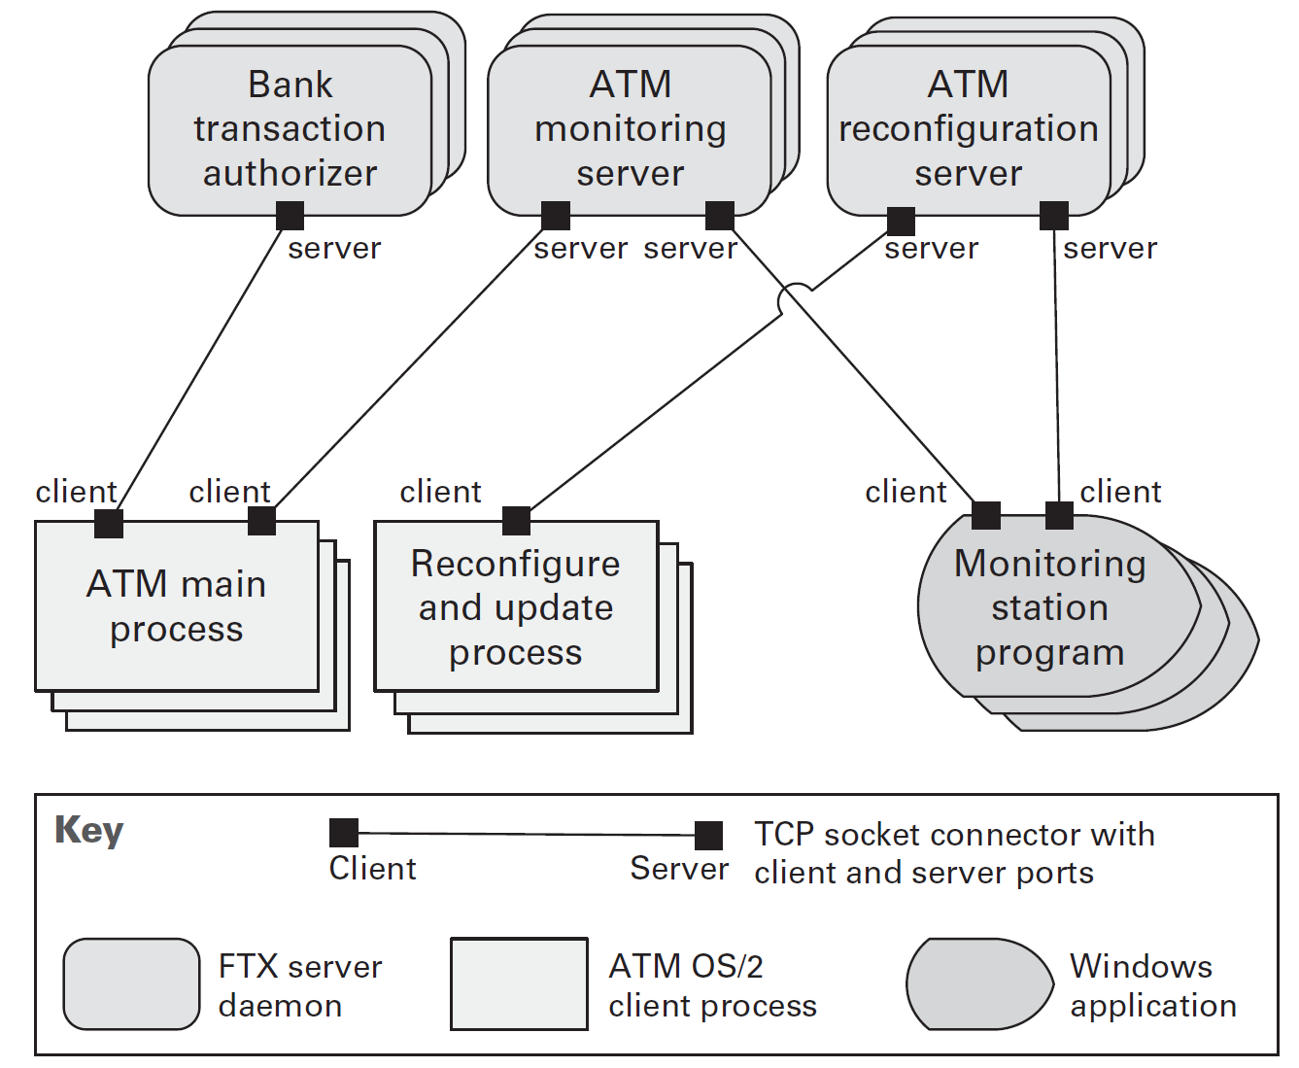
Client-Server Style
Clients are connected to servers through request/reply connectors.
Server components can be clients to other servers.
Specializations may impose restrictions:
Numbers of attachments to a given port
Allowed relations among servers

Slide 44
Why Client-Server Style?
The client-server style presents a system view that separates client applications from the services they use.
This style supports system understanding and reuse by factoring out common services.
Because servers can be accessed by any number of clients, it is relatively easy to add new clients to a system.
Similarly, servers may be replicated to support scalability or availability.

Slide 45
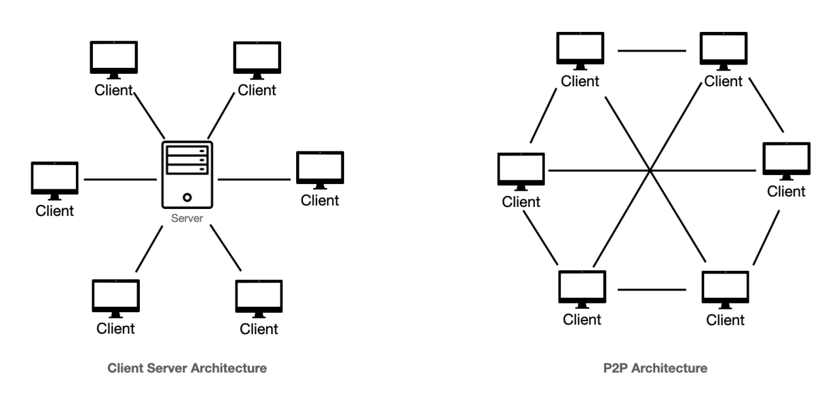
Peer-to-Peer Style
Restrictions may be placed on the number of allowable attachments to any given port, or role.
Special peer components can provide routing, indexing, and peer search capability.
Specializations may impose visibility restrictions on which components can know about other components.

Slide 46
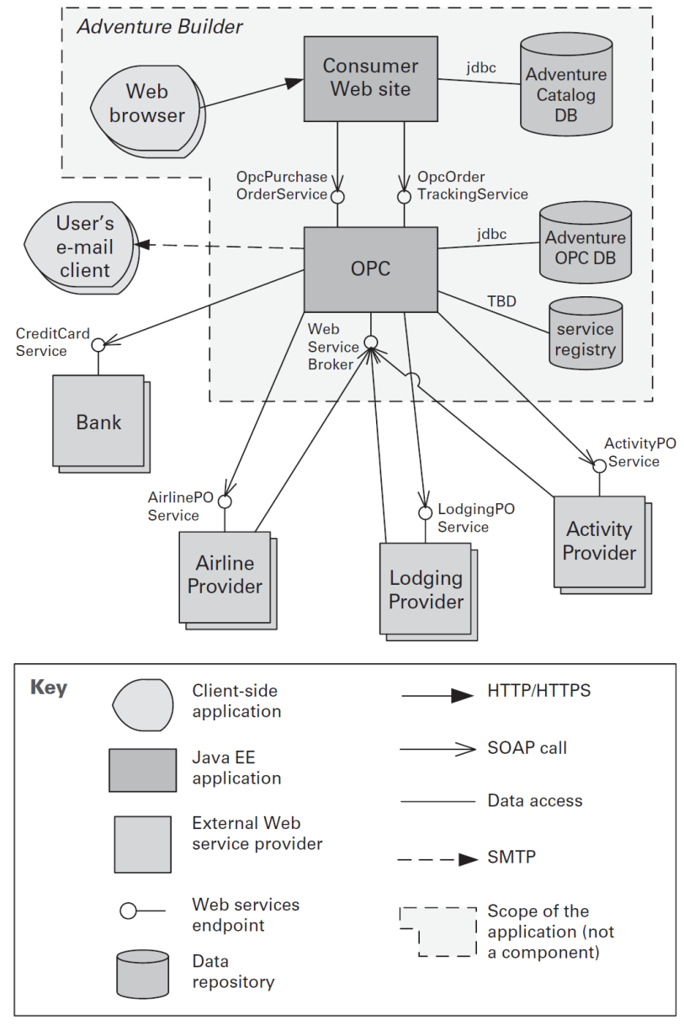
Service-Oriented Architecture Style
Service consumers are connected to service providers, but intermediary components (such as ESB, registry, or BPEL server) may be used.
ESBs lead to a hub-and-spoke topology.
Service providers may also be service consumers.
The main benefit and the major driver of SOA is interoperability.

Slide 47
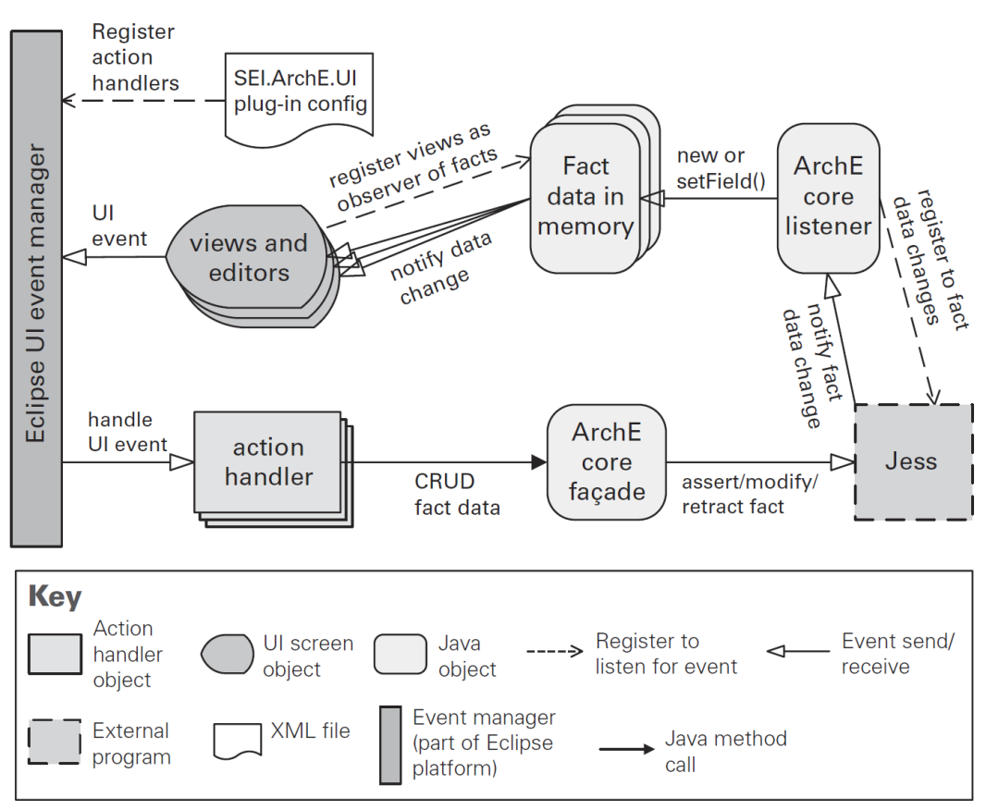
Publish-Subscribe Style
All components are connected to an event distributor that may be viewed as either a bus—that is, a connector—or a component.
Publish ports are attached to announce roles, and subscribe ports are attached to listen roles.
The publish-subscribe style is used to send events and messages to an unknown set of recipients.

Slide 48
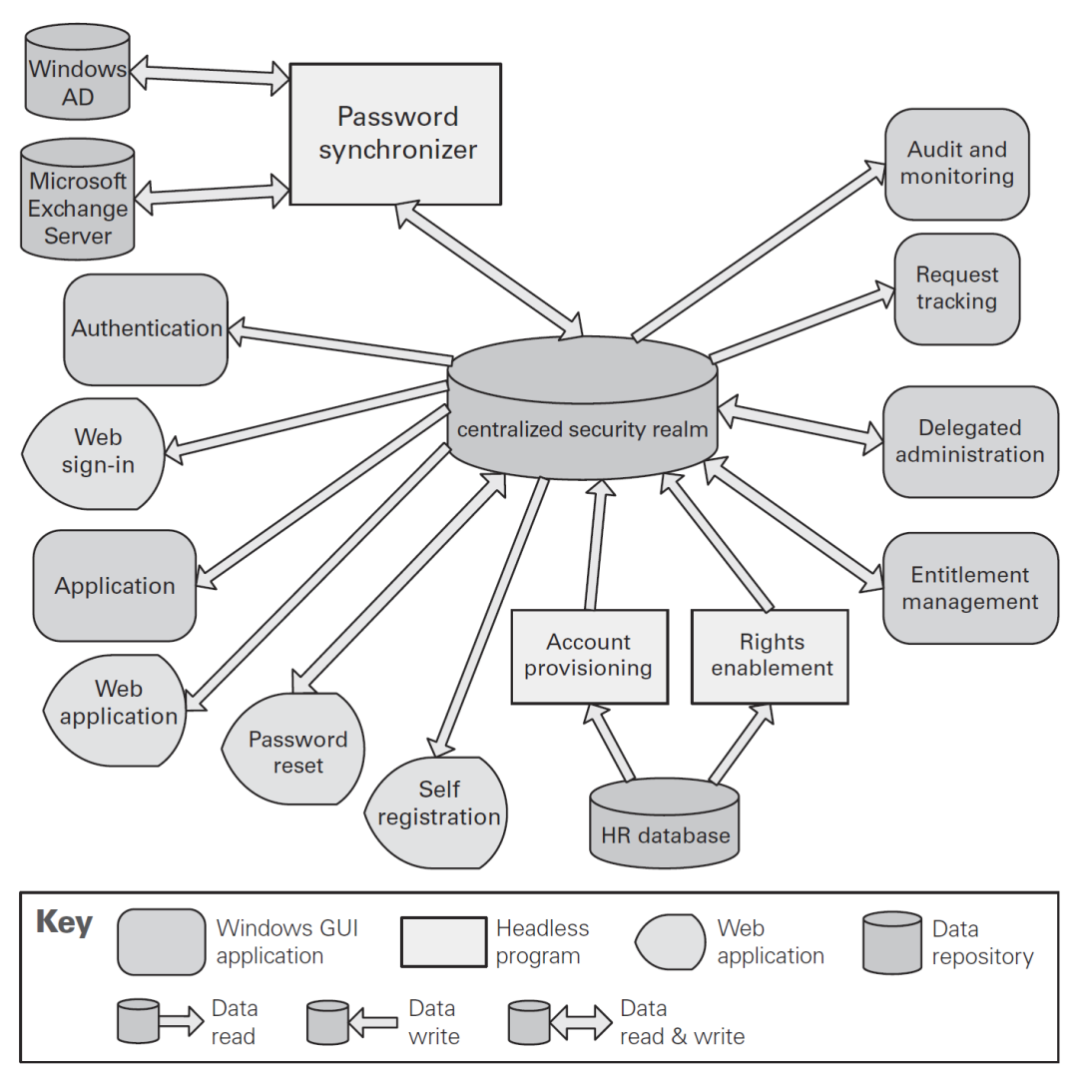
Shared-Data Style

Slide 50
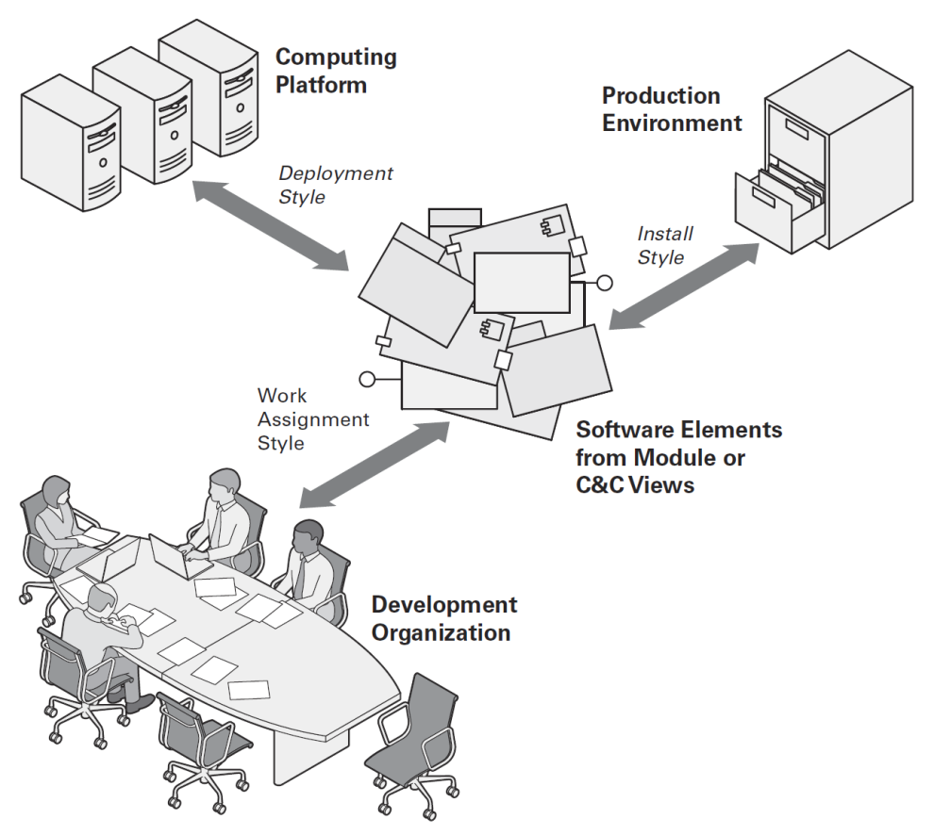
Allocation Views and Allocation Styles
Allocation views present a mapping between software elements (from either a module view or a component-and-connector [C&C] view) and nonsoftware elements in the software’s environment.
Allocation styles
Deployment style
Install style
Work assignment style

Slide 51
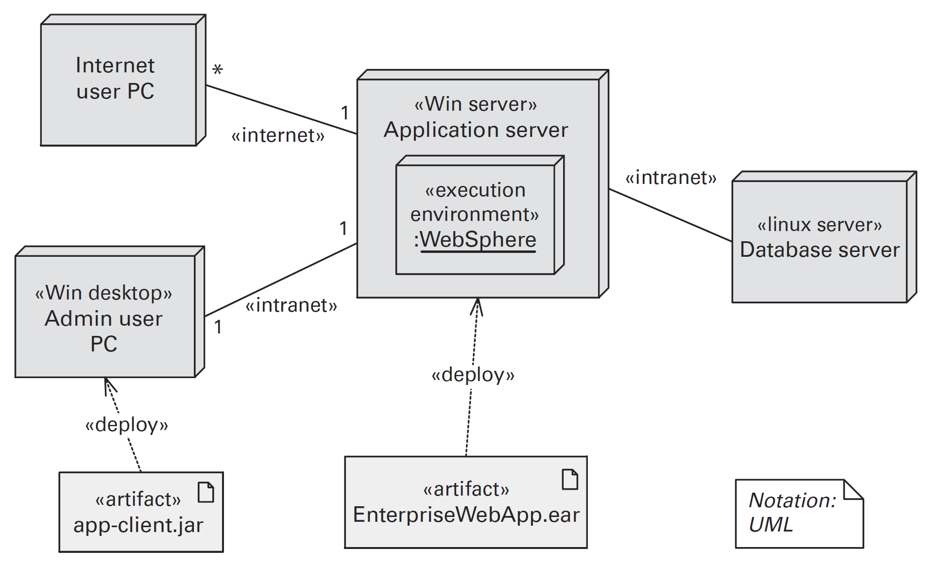
Example Deployment View

Slide 52
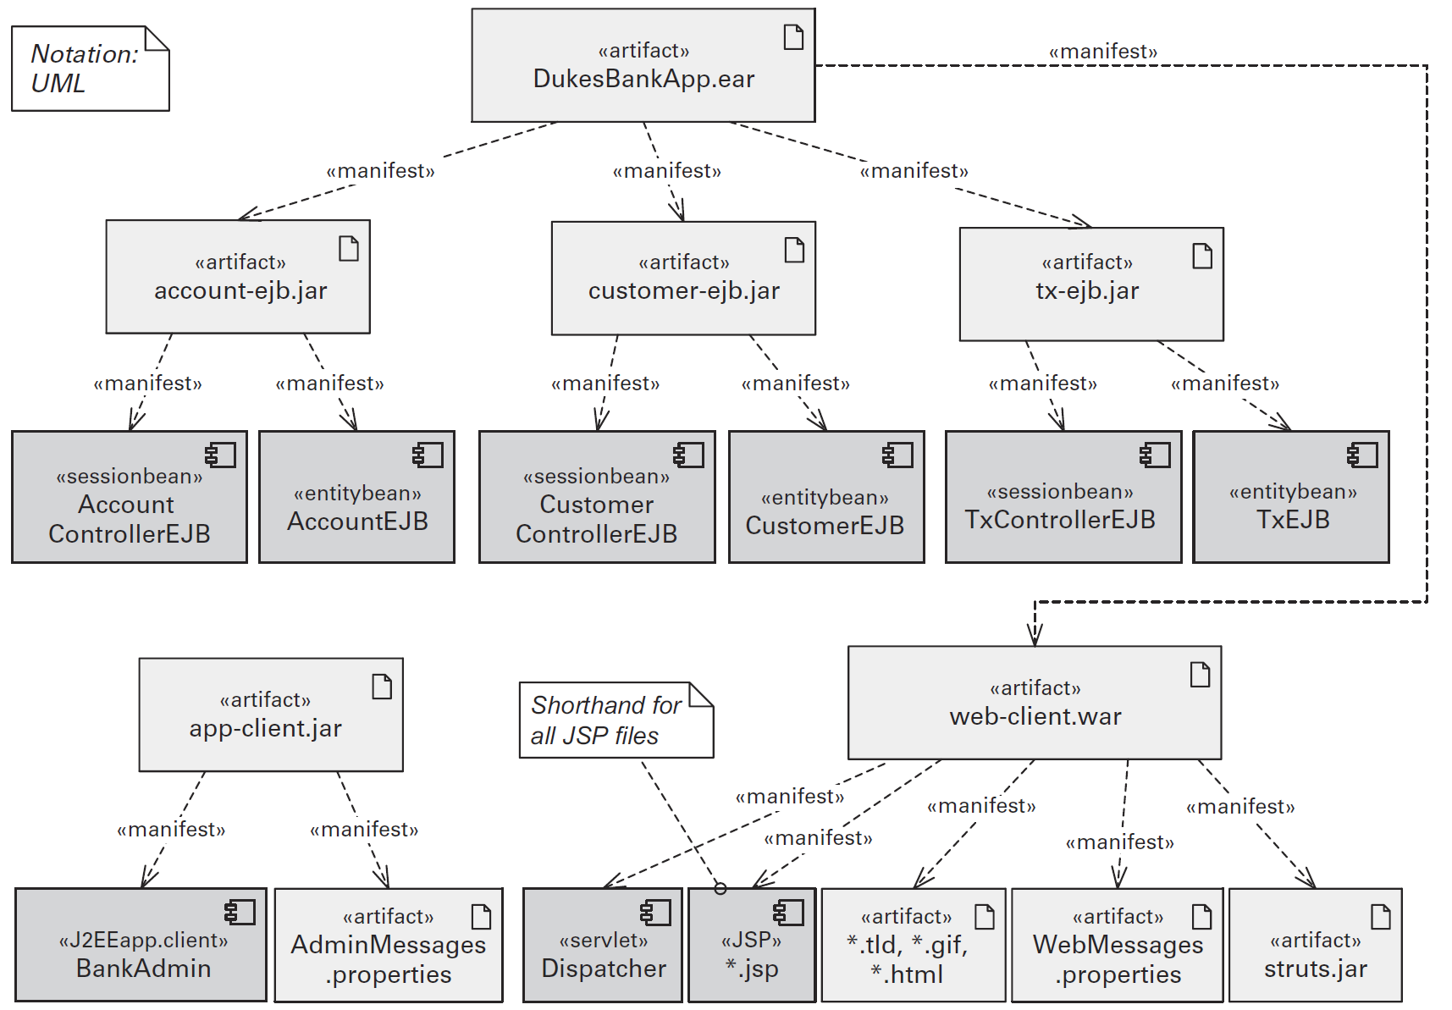
Example Install View

Slide 53
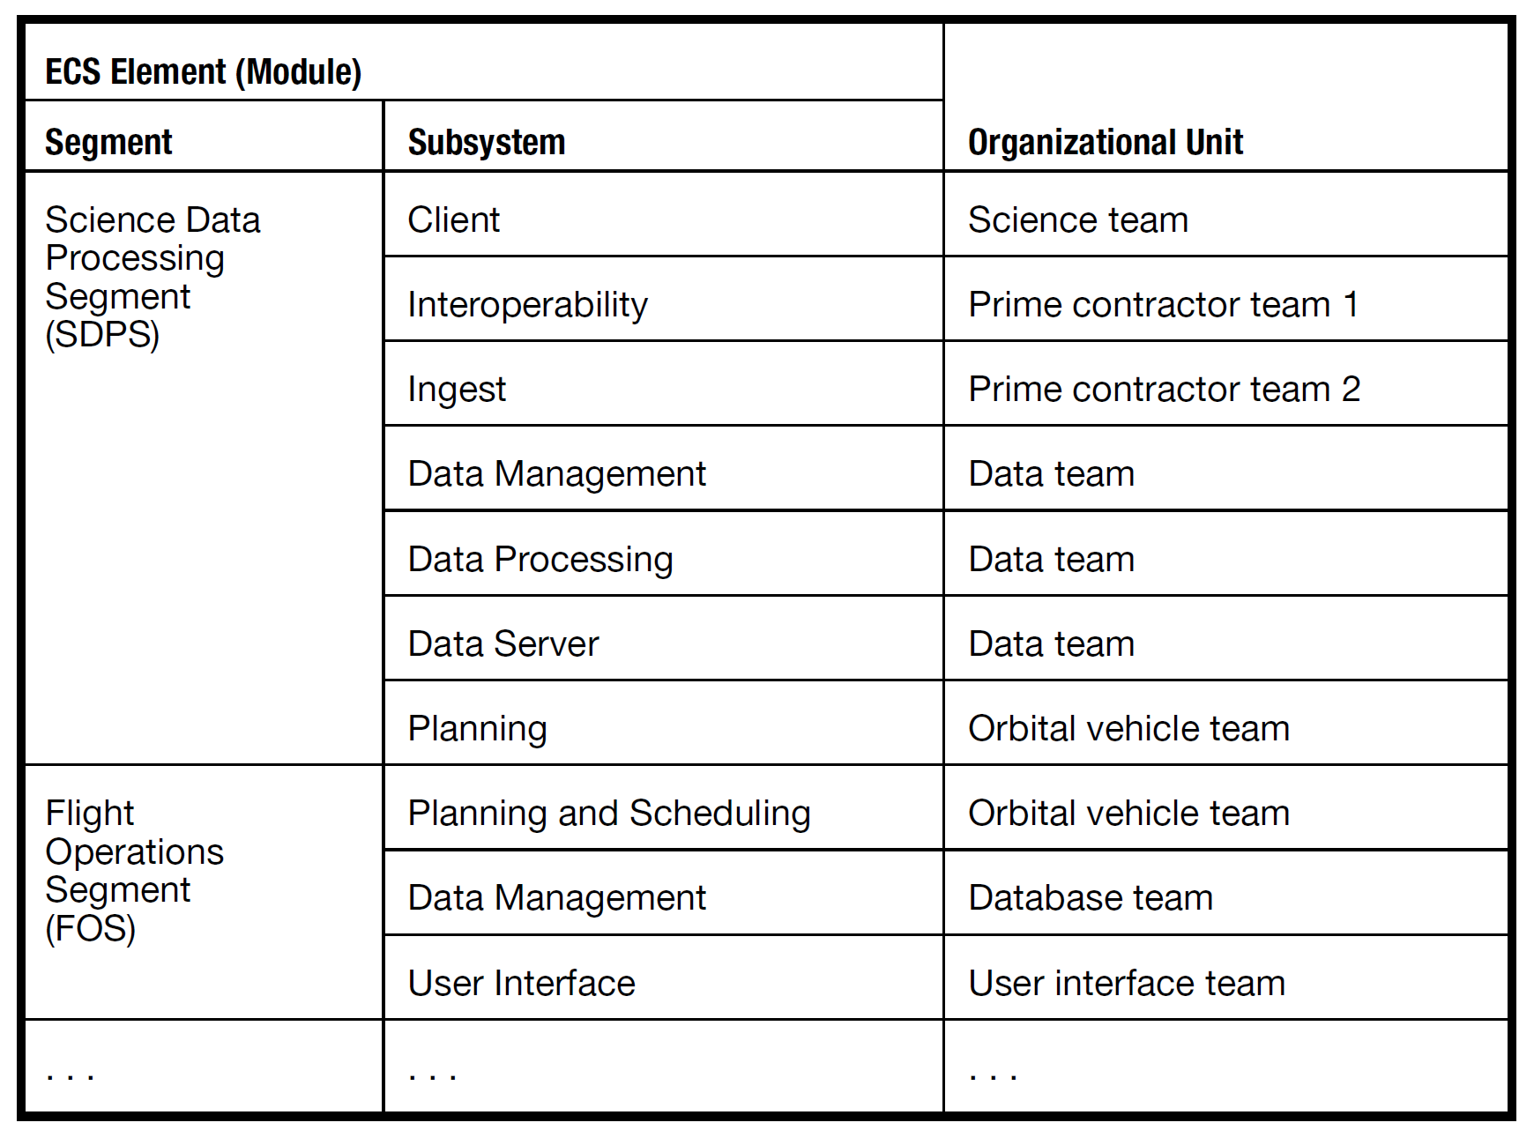
Example Work Assignment View

Slide 54

Further Reading
Lenny Delligatti (2013). SysML Distilled A Brief Guide to the Systems Modeling Language. Addison-Wesley Professional.

Slide 55

Thank You & See You Again

